Slide 1

AUT Course Enrolment System Phase 2
Presented by Thanh Tran
Notes:
Hi everyone, I’m Thanh. Today, I will present the process of building a system for a selected organisation.

Slide 2
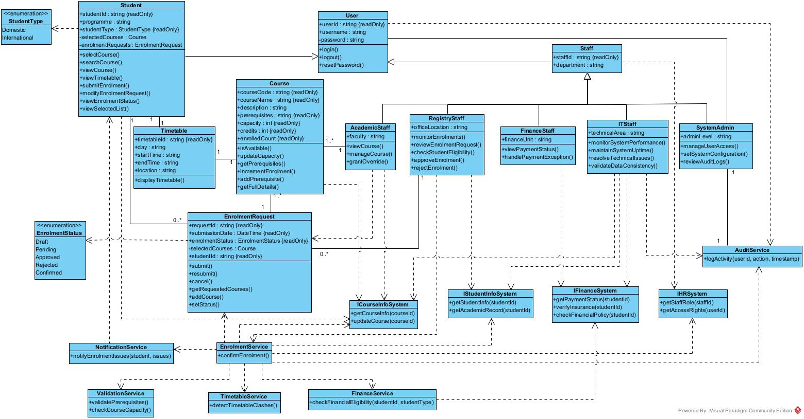
Phase 1’s Class Diagram
Notes:
The organisation I have chosen is AUT. It is one of the largest universities in New Zealand, established in 2000. In 2025, it has over 26,000 students and over 4,000 staff members. AUT has three campuses and offers a wide range of programmes. AUT has complex organisational structure

Slide 3
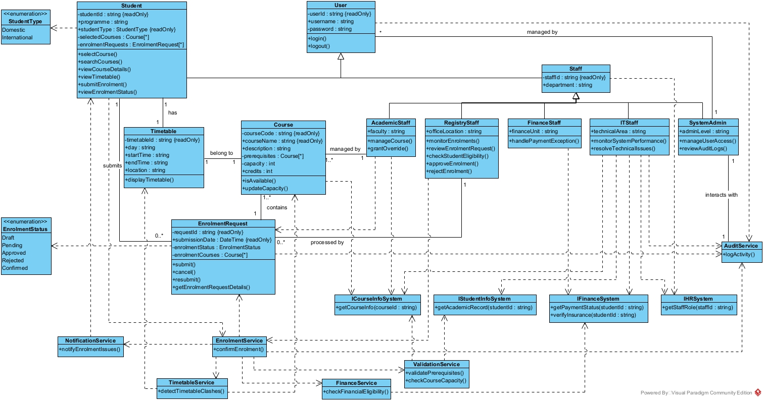
Refined Class Diagram
Notes:
It has many departments. For example,

Slide 4
Sequence Diagrams
Model dynamic behaviour of the system
Show interaction between classes, users, and external systems
Illustrate message flow and system responsibilities
Represent main system workflow and improve UML–code consistency
Key scenarios:
Student Login
Course Selection and Enrolment
Enrolment Review and Approval (Registry Staff)
Notes:
For each department, it requires a system to support its operation. For example, …. I will focus on Course Enrolment System in my project

Slide 5
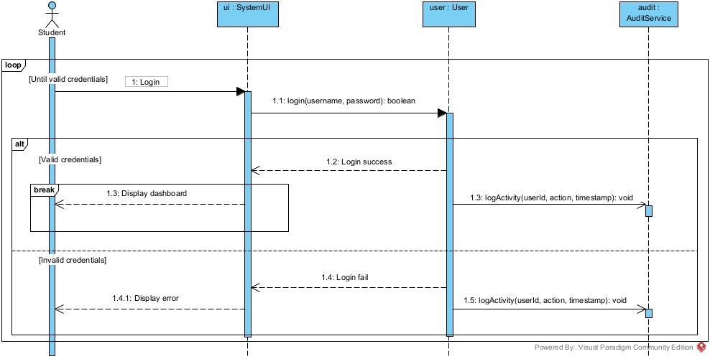
Sequence Diagram - Student Login
Notes:
In current state, the Course Enrolment System of AUT is processing manual and paper-based. This leads to several issue like lost, missing paper, delays in enrolment process, inconsistent data. Therefore, AUT need to building an online Course Enrolment System to improve efficiency, accuracy, and accessibility

Slide 6
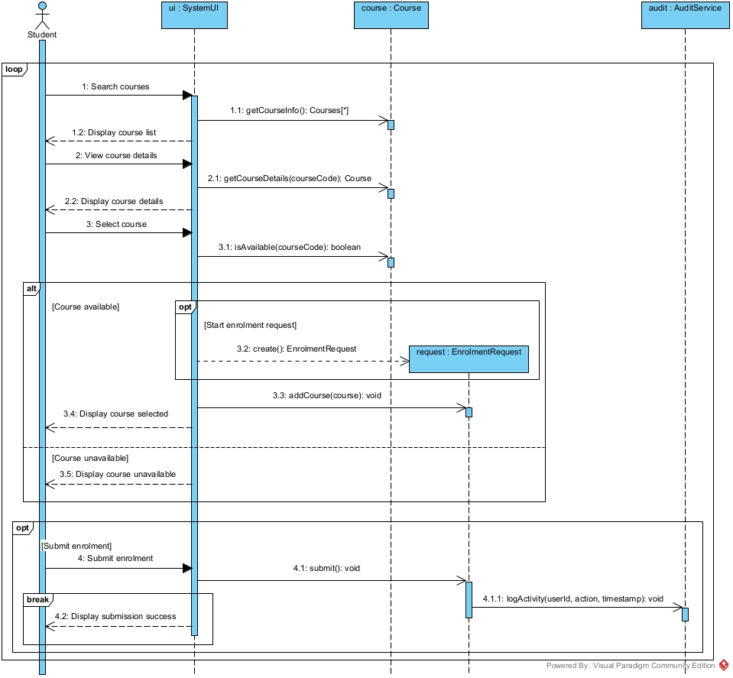
Sequence Diagram - Course Selection & Enrolment
Notes:
For the new system, AUT requite it to integrate with Student Information System, Course Information System, HR System, Finance System.
Some of the require for this system is it need to support domestic and internation

Slide 7
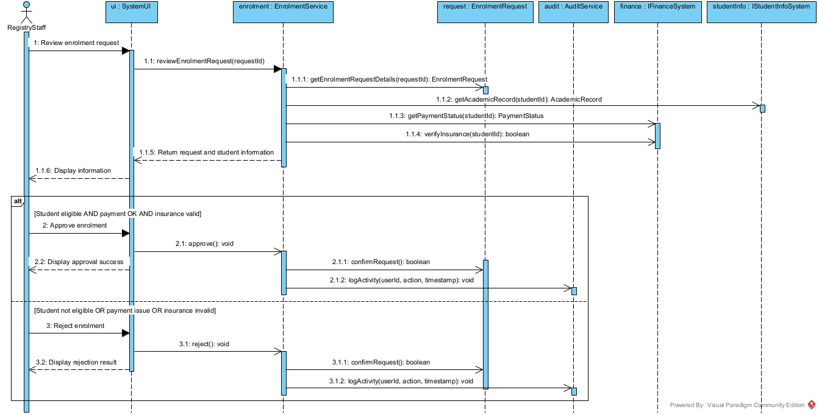
Sequence Diagram - Enrolment Review & Approval
Notes:
Based on the problem statement, I identified these stakeholder

Slide 8
Activity Diagrams
Model system workflow and process flow
Focus on decisions, actions, and responsibilities
Use swimlanes to separate users, system, and external services
Improve understanding of system behaviour from a process perspective
Key scenarios:
Student course enrolment workflow
Registry staff enrolment review and approval
Notes:
I also defined system scope and boundary.
This system focuses on enrolment-related functions like searching, selecting, and enrolling in courses, checking enrolment validation, supporting approval workflows, integrating with external systems for data retrieval, and visualising timetables.
It will not handle grading, transcripts, teaching, or payroll, and it does not directly modify data in external systems.

Slide 9
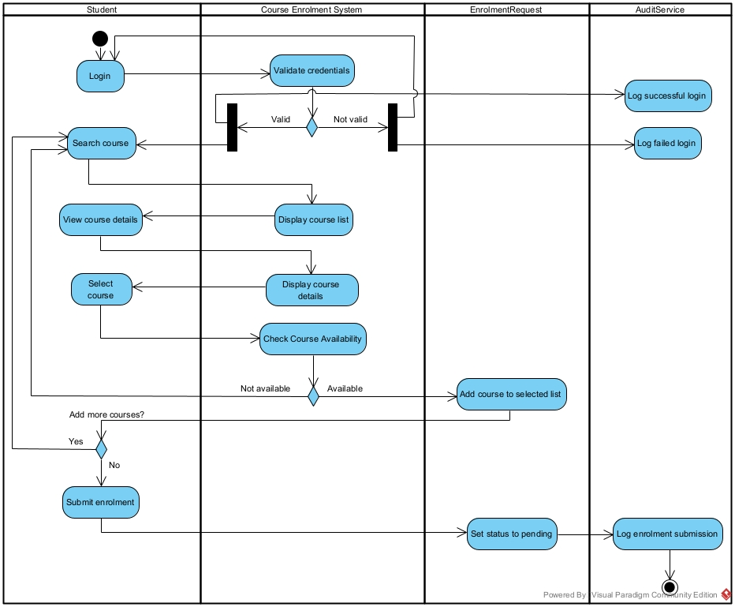
Activity Diagram -Student Enrolment
Notes:
I also make some assumption for this question such as users have internet access and web browser, external systems provide accurate data

Slide 10
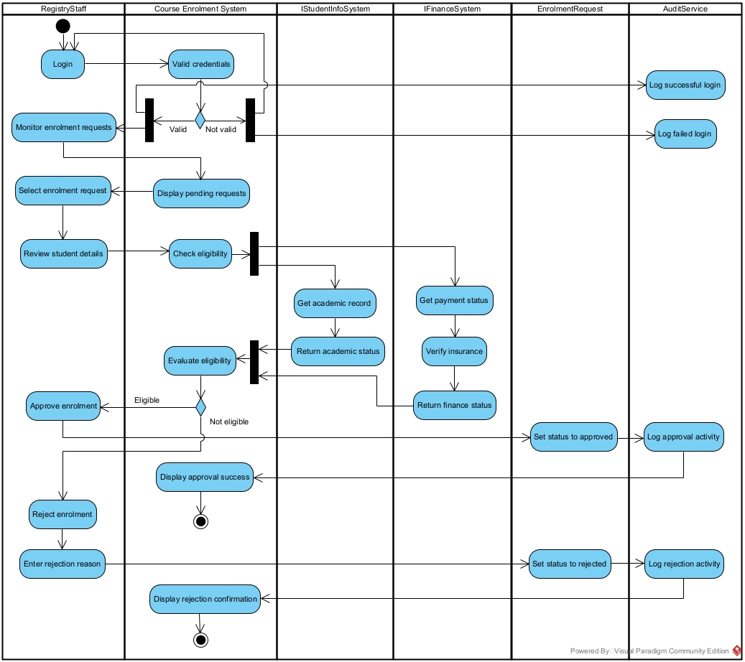
Activity Diagram - Registry Approval
Notes:
After considering the system scope, boundaries, and assumptions, I started the first step of system development, which is requirements analysis. To do the requirements analysis, I use some Requirements Elicitation Methods to do it, including Problem statement analysis, Existing document analysis, Observation of current enrolment process, and Stakeholder interviews

Slide 11
Design Patterns
Applied GoF design patterns to improve system design
Focus on modularity, flexibility, and maintainability
Key Advantages:
Reduced Coupling
Increased Cohesion
Enhanced Extensibility
Three patterns used:
Factory Method
Singleton
Adapter
Address key design concerns:
Object creation (Factory Method)
Global access control (Singleton)
External system integration (Adapter)
Notes:
From the requirement analysis, I identified the functional requirement of the system. Some key requirements such as user login, and role-based control, Course search, selection, and enrolment, Payment status integration, Timetable visualisation and clash detection

Slide 12
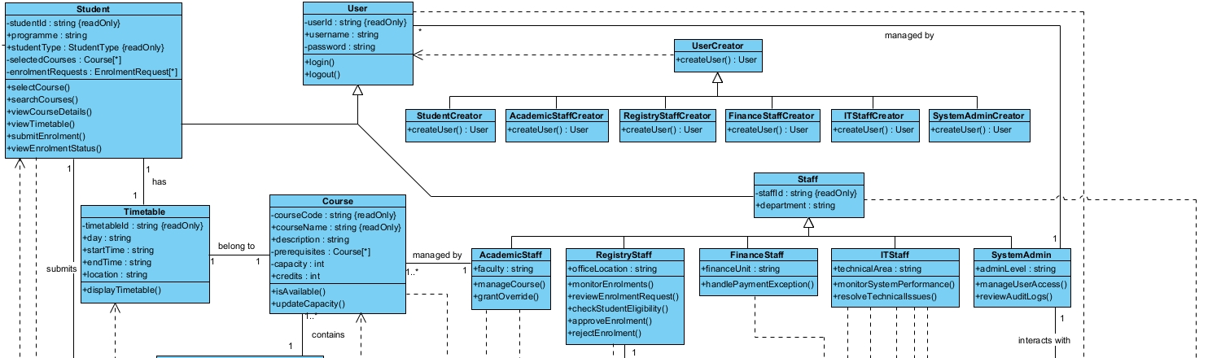
Factory Method Pattern
Main components:
Product (abstract class / interface)
Concrete product
Creator (abstract class)
Concrete creator
Client
Key benefits:
Reduces coupling
Improves extensibility
Follows Open/Closed Principle
Centralises object creation
Improves maintainability
Notes:
Beside the functional requirement, I also define non-functional requirement such as Performance, Security, Reliability, Compatibility, Scalability, Usability

Slide 13
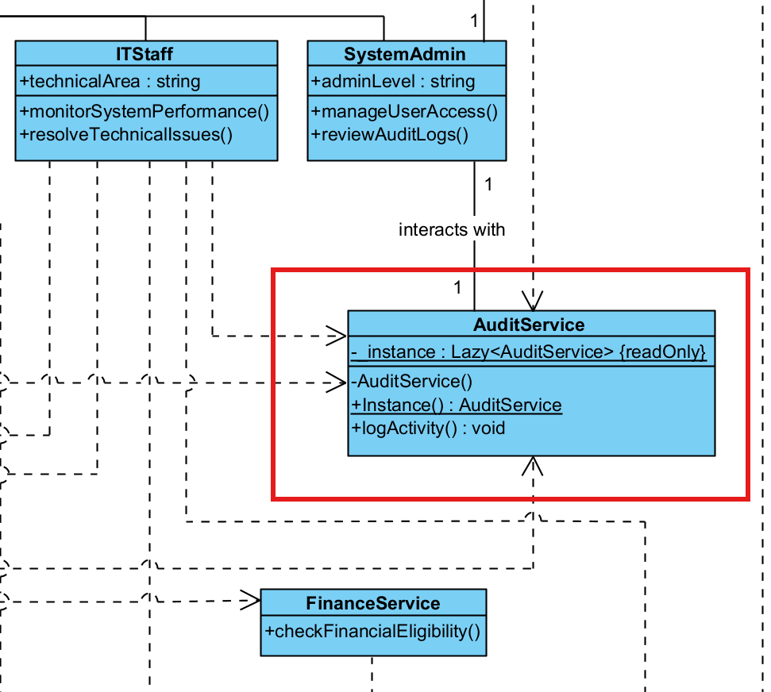
Singleton Pattern
Main components:
Singleton class
Private constructor
Static member
Static factory method
Key benefits:
Ensures only one instance exists
Provides global access to shared service
Improves consistency
Supports controlled resource management
Notes:
After doing the system requirement analysis, I did UML requirements modelling, which convert functional requirements into visual system behaviour

Slide 14
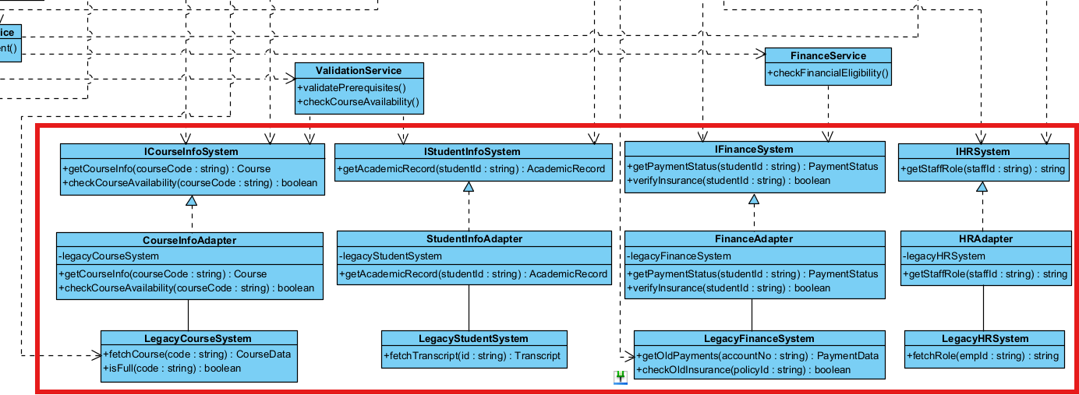
Adapter Pattern
Main components:
Target interface
Adaptee (legacy system)
Adapter
Client
Key benefits:
Integrates legacy systems
Converts incompatible interfaces
Reduces impact of external changes
Improves flexibility and reuse
Separates system from external services
Notes:
Frist step is defining system actor, I defined some primary actor including student, Academic Department Staff, Academic Registry Staff, Finance Staff, System Administrator, IT Staff
Beside primary actor, there are also external system actor including Student Information System, Course Information System, Finance System, HR System

Slide 15
Overall Design Improvements
Improved system modularity through separation of responsibilities
Reduced coupling between classes and external systems
Increased cohesion within key modules (creation, logging, integration)
Introduced abstraction layers for better system structure
Improved scalability and extensibility for future requirements
Enhanced maintainability through reusable and flexible components
Clear separation of concerns:
Object creation (Factory Method)
Global logging (Singleton)
External system integration (Adapter)
Notes:
After defining actor, I identifying there use case which are similar to the functional requirement

Slide 16
Comparative Analysis
Original design had high coupling and direct dependencies
Object creation, logging, and external systems were tightly integrated
After applying patterns:
Responsibilities were separated into dedicated components
Abstraction reduced dependency on concrete classes
System became more modular and easier to extend
Key improvements:
Higher cohesion within modules
Lower coupling across system
Better system structure and clarity
Trade-off:
Increased implementation complexity due to additional abstraction layers
Notes:
For next step, I identified the use case relationships, which are include, extend, and generalisation

Slide 17
Critical Reflection
Design patterns improved structure but introduced additional complexity
Trade-offs exist between simplicity and scalability
Singleton improves consistency but introduces global dependency risk
Factory Method increases flexibility but adds more classes
Adapter improves compatibility but increases structural layers
UML models provide guidance but do not fully match implementation
C# implementation requires refinement beyond diagram design

Slide 18
Thank You For Listening!

